Slide 1



English Year 6
UNIT 1- WELCOME

Slide 2



Learning Objectives
By the end of the lesson, pupils will be able to:
Read the text and identify the main idea.
Describe personality.
Understand with little or no support, specific information and details of longer simple texts on a range of familiar topics.
Recognise and reproduce independently, a wide range of target language phonemes.
1.
2.
3.
4.

Slide 3




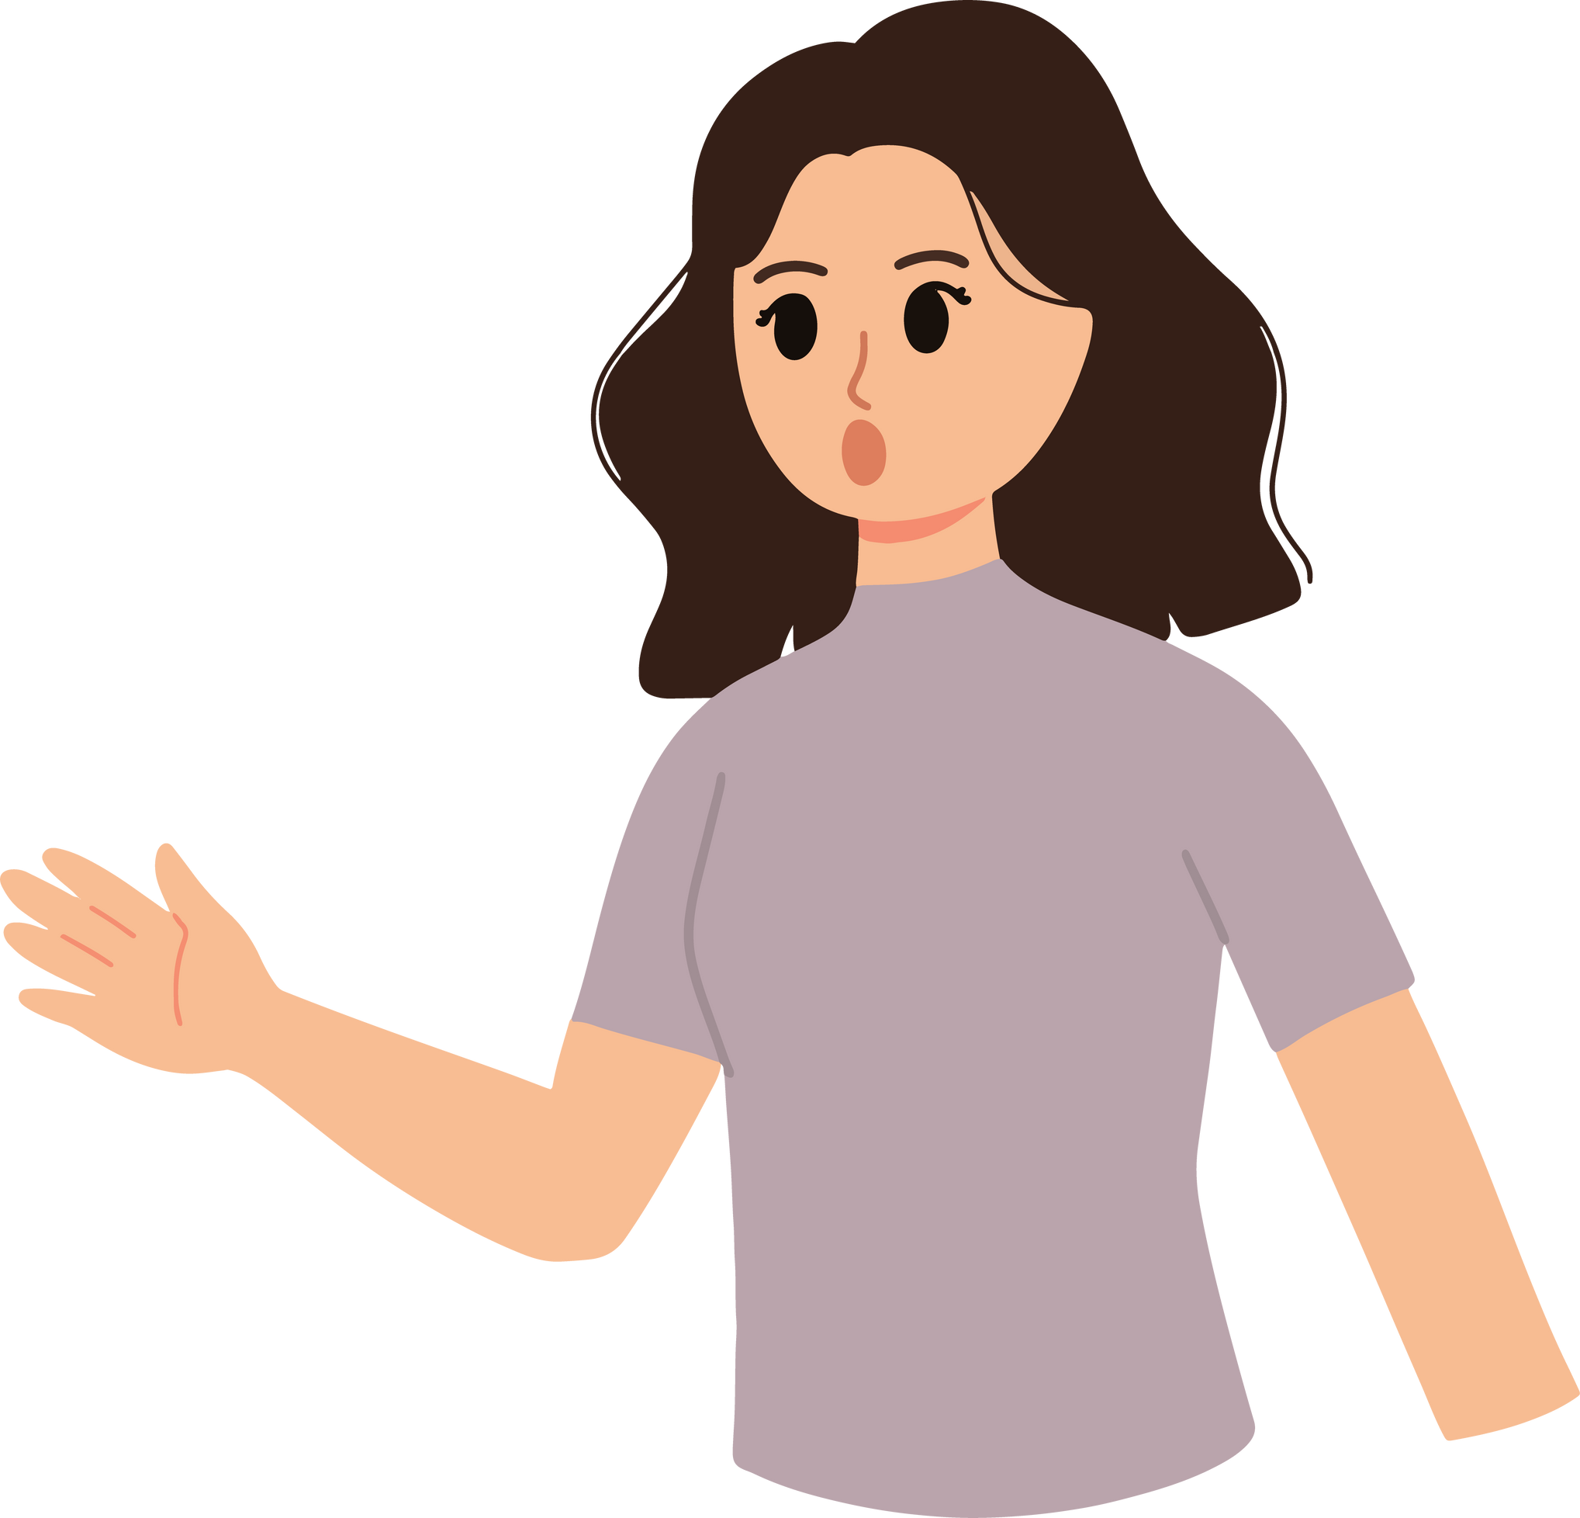
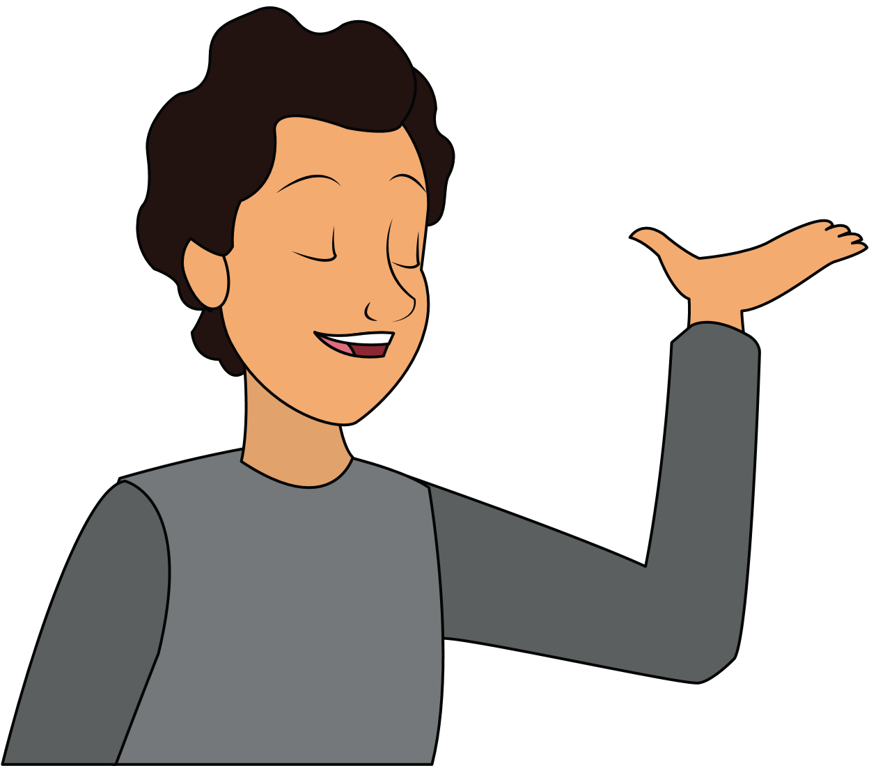
Read the dialogues below.
Hello, I'm Sophia and I'm 12. I love Science and Technology. This year, I want to learn how we make different products , like clothes and food.
Hey, I'm Oliver.
This year, I want to discuss interesting topics and listen to different opinions on them.
Hello, I'm Alice.
I love reading.
This year, I want to learn how to write about stories I enjoy.

Slide 4
Do you remember them?

Slide 5


Getting to Know Someone
Simple present questions are used to gather information about someone or something.
They often begin with question words like "who," "what," "where," "when," "why," "how," or "how many."

Slide 6



Questions
Answers
Who is your favourite singer?
My favourite singer is Taylor Swift.
What is your favourite hobby?
My favourite hobby is playing soccer.
Where do you live?
I live in London.

Slide 7


Let's practise asking and answering questions about ourselves.
Pair up with a classmate and take turns asking and answering questions.
Example:
Student A: How many people are there in your family?
Student B: There are four people in my family.
Student B: What is your favourite subject in school?
Student A: My favourite subject is Science.
Practise this

Slide 8



THANK YOU!

